Slide 1
MPCA LAB MINI PROJECT PROJECT TITLE: Air quality monitoring system
SUBMITTED BY
STUDENT NAME: SRN:
1.Deepali Attavar PES2UG19CS106
2.Lasya Priya PES2UG19CS111
3.Geethika Kommineni PES2UG19CS127
4.GP Prerna PES2UG19CS134
SECTION: B

Slide 2
PROBLEM STATEMENT
Implementing an Air Quality Monitoring System on Tinkercad

Slide 3
INTRODUCTION
Atmospheric conditions still deteriorate annually because of the expansion of civilization and increasing unclean emissions from industries and automobiles, leading to very adverse effects on each the surroundings and on human health.
This project aims to develop an air quality monitoring system that shall monitor the ppm in air in real time, observe the standard of air and alert people once the standard of air is poor.
This project uses arduino online simulator (Tinkercad) to monitor the air quality and supply a statistical report. The sensing element used for monitoring the pollution is the MQ-135 gas sensor. The sensing element knowledge is displayed on a character LCD and a piezo is employed to buzz once needed in keeping with the air quality

Slide 4
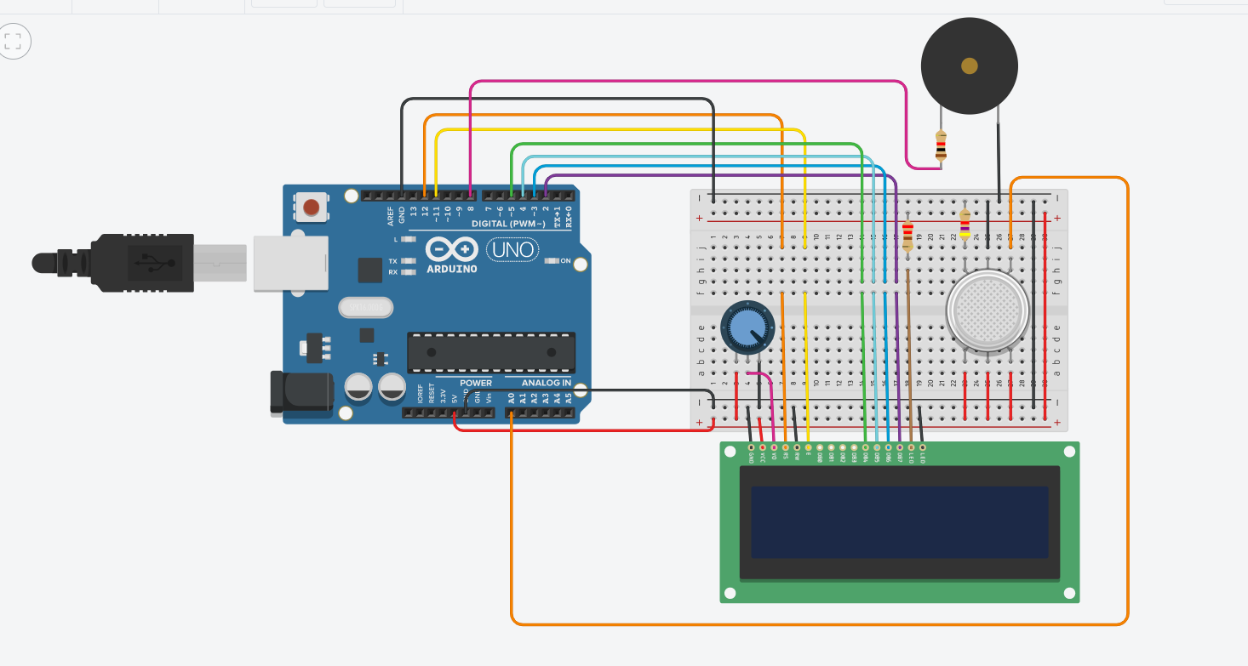
BLOCK DIAGRAM

Slide 5
REQUIRED COMPONENTS
Arduino Uno R3
16X2 Character LCD
MQ135 Gas Sensor
Piezo
Potentiometer
Breadboard Small
Resistors
Wires

Slide 6
PROJECT DESCRIPTION
Connections
LCD RS pin to digital pin 12
LCD Enable pin to digital pin 11
LCD D4 pin to digital pin 5
LCD D5 pin to digital pin 4
LCD D6 pin to digital pin 3
LCD D7 pin to digital pin 2
LCD R/W pin to ground
LCD VSS pin to ground
LCD VCC pin to 5V
10K resistor:
ends to +5V and ground
wiper to LCD VO pin (pin 3)

Slide 7
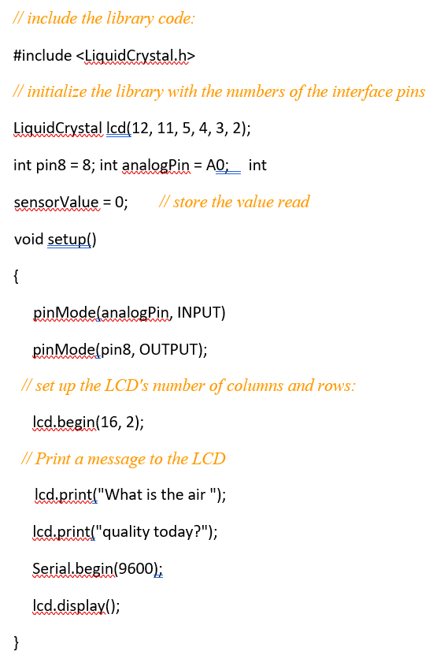
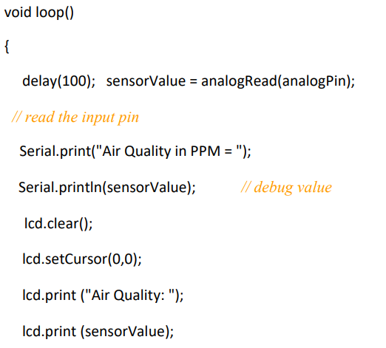
PROJECT DESCRIPTION: Arduino Code

Slide 8
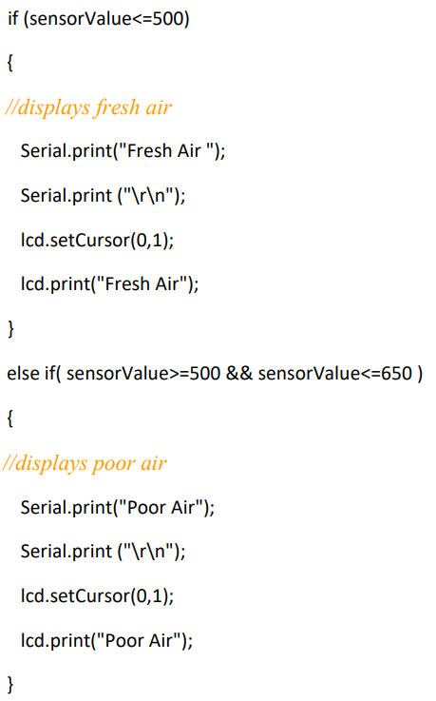
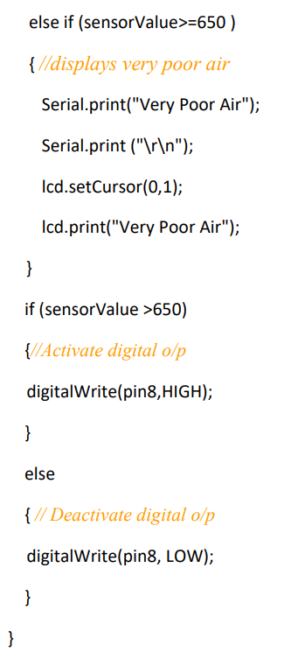

Slide 9
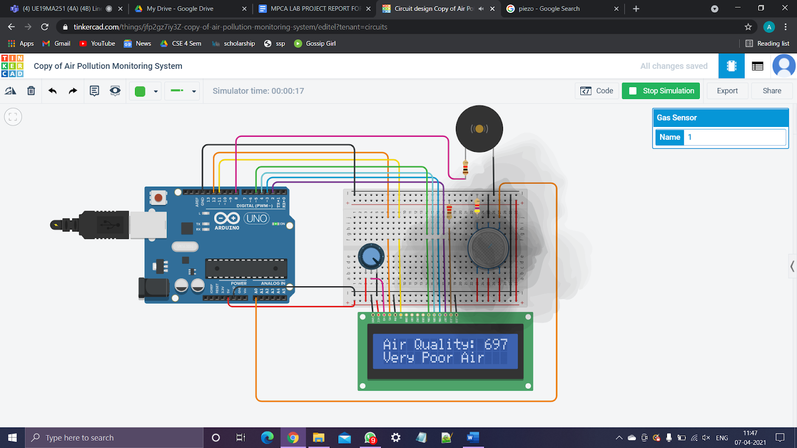
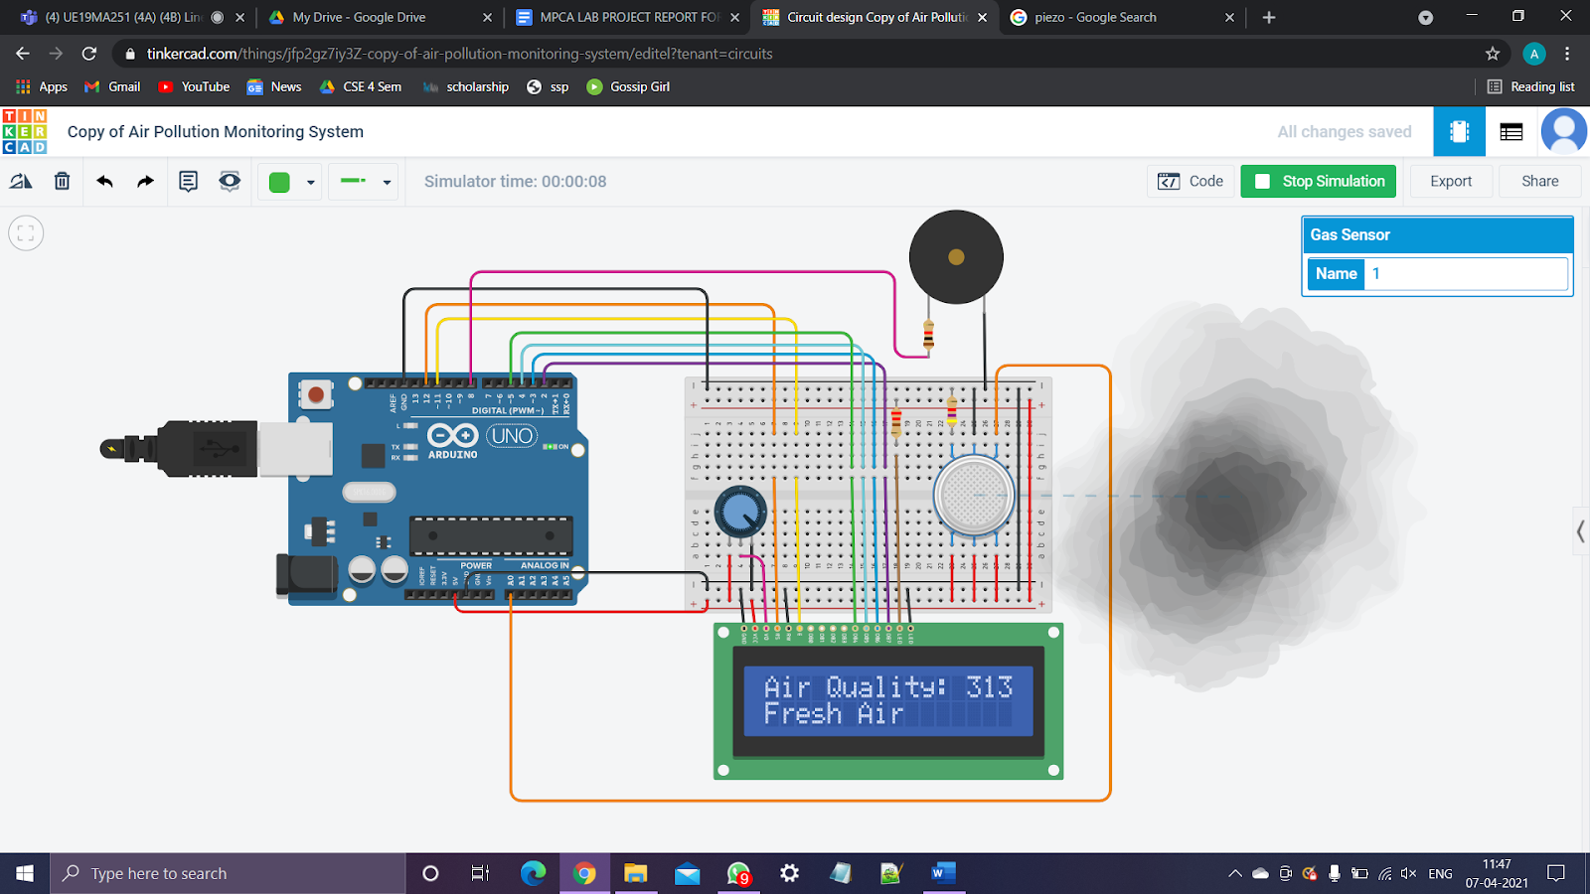
PROJECT DESCRIPTION: Output screenshots
Some sample output screenshots which show (i) Very poor air
and
(ii) Fresh air

Slide 10
APPLICATIONS
With air quality monitoring systems, industries can detect the presence of these toxics and monitor air quality to take intelligent measures to improve the quality of air for their workers. This leads to an increase in productivity, reduced equipment damage, and effective regulatory compliance.
Indoor air quality and roadside pollution monitoring.
Low operating costs and high quality data
In Gas Detection Systems where harmful gases and toxins may be produced or during manufacturing processes where even a minor leakage may lead to a catastrophe.
To make this data available to the common man.

Slide 11
REFERENCES(Website links, Books etc.)
● https://www.tinkercad.com/things/ikdA3Clop1f-working-with-piezo-buzzer
● https://www.tinkercad.com/things/8Ci8AMZXvVZ-gas-sensor-value-analog-read
●https://www.youtube.com/results?search_query=tinkercad+gas+sensor

Slide 12
THANK YOU

